Slide 1


Strategic Dashboard
Board of Education
February 21, 2024

Slide 2
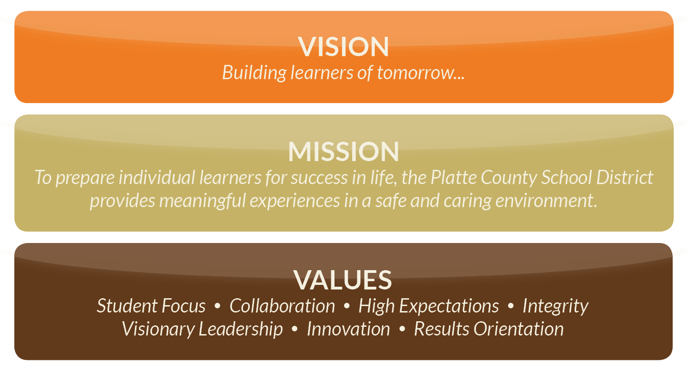

Slide 3
Superintendent’s Goal
Goal Statement: The superintendent will lead the development of the building principals and central office leaders with a focus on visioning, systems-thinking, safe and caring environments, student achievement, and metrics.
Action Step:
Creation of performance dashboard to track and monitor KPIs with benchmarking and SMART goals aligned to organizational priorities.

Slide 4
Research Process
Definition of Project Scope
  Clearly outlined the scope of work for the project, establishing key objectives and deliverables
Vendor Evaluation
  Conducted individual meetings with three reputable dashboard companies to explore potential partnerships
Competitive Quotes
  Solicited and received comprehensive quotes from each vendor, detailing the proposed cost and services
Team Assessment
  Collaboratively evaluated the quotes, considering their alignment with the project scope and assessing each vendor’s ability to meet project requirements
Superintendent’s Cabinet Presentation
  Presented findings and recommendations to the Superintendent’s Cabinet, followed by a demo of the product
Board of Education Proposal

Slide 5
Technical Scope
This project aims to generate comprehensive MSIP reports encompassing the scope below. These reports will offer an in-depth analysis of key educational metrics, serving as foundational tools for informed decision making and targeted strategies to enhance academic outcomes and foster an environment conducive to holistic student development.
  Overall Enrollment
  Attendance
  Graduation Rate (projected)
  MAP and EOC exam scores
  CCR Assessments (ACT, SAT, ASVAB)
  On track for graduation (9th - 11th grades)
  GPA
  ICAP (Individual Career and Academic Plan)
  Current Student Grades
  Success readiness and Assessments (Fastbridge)

Slide 6
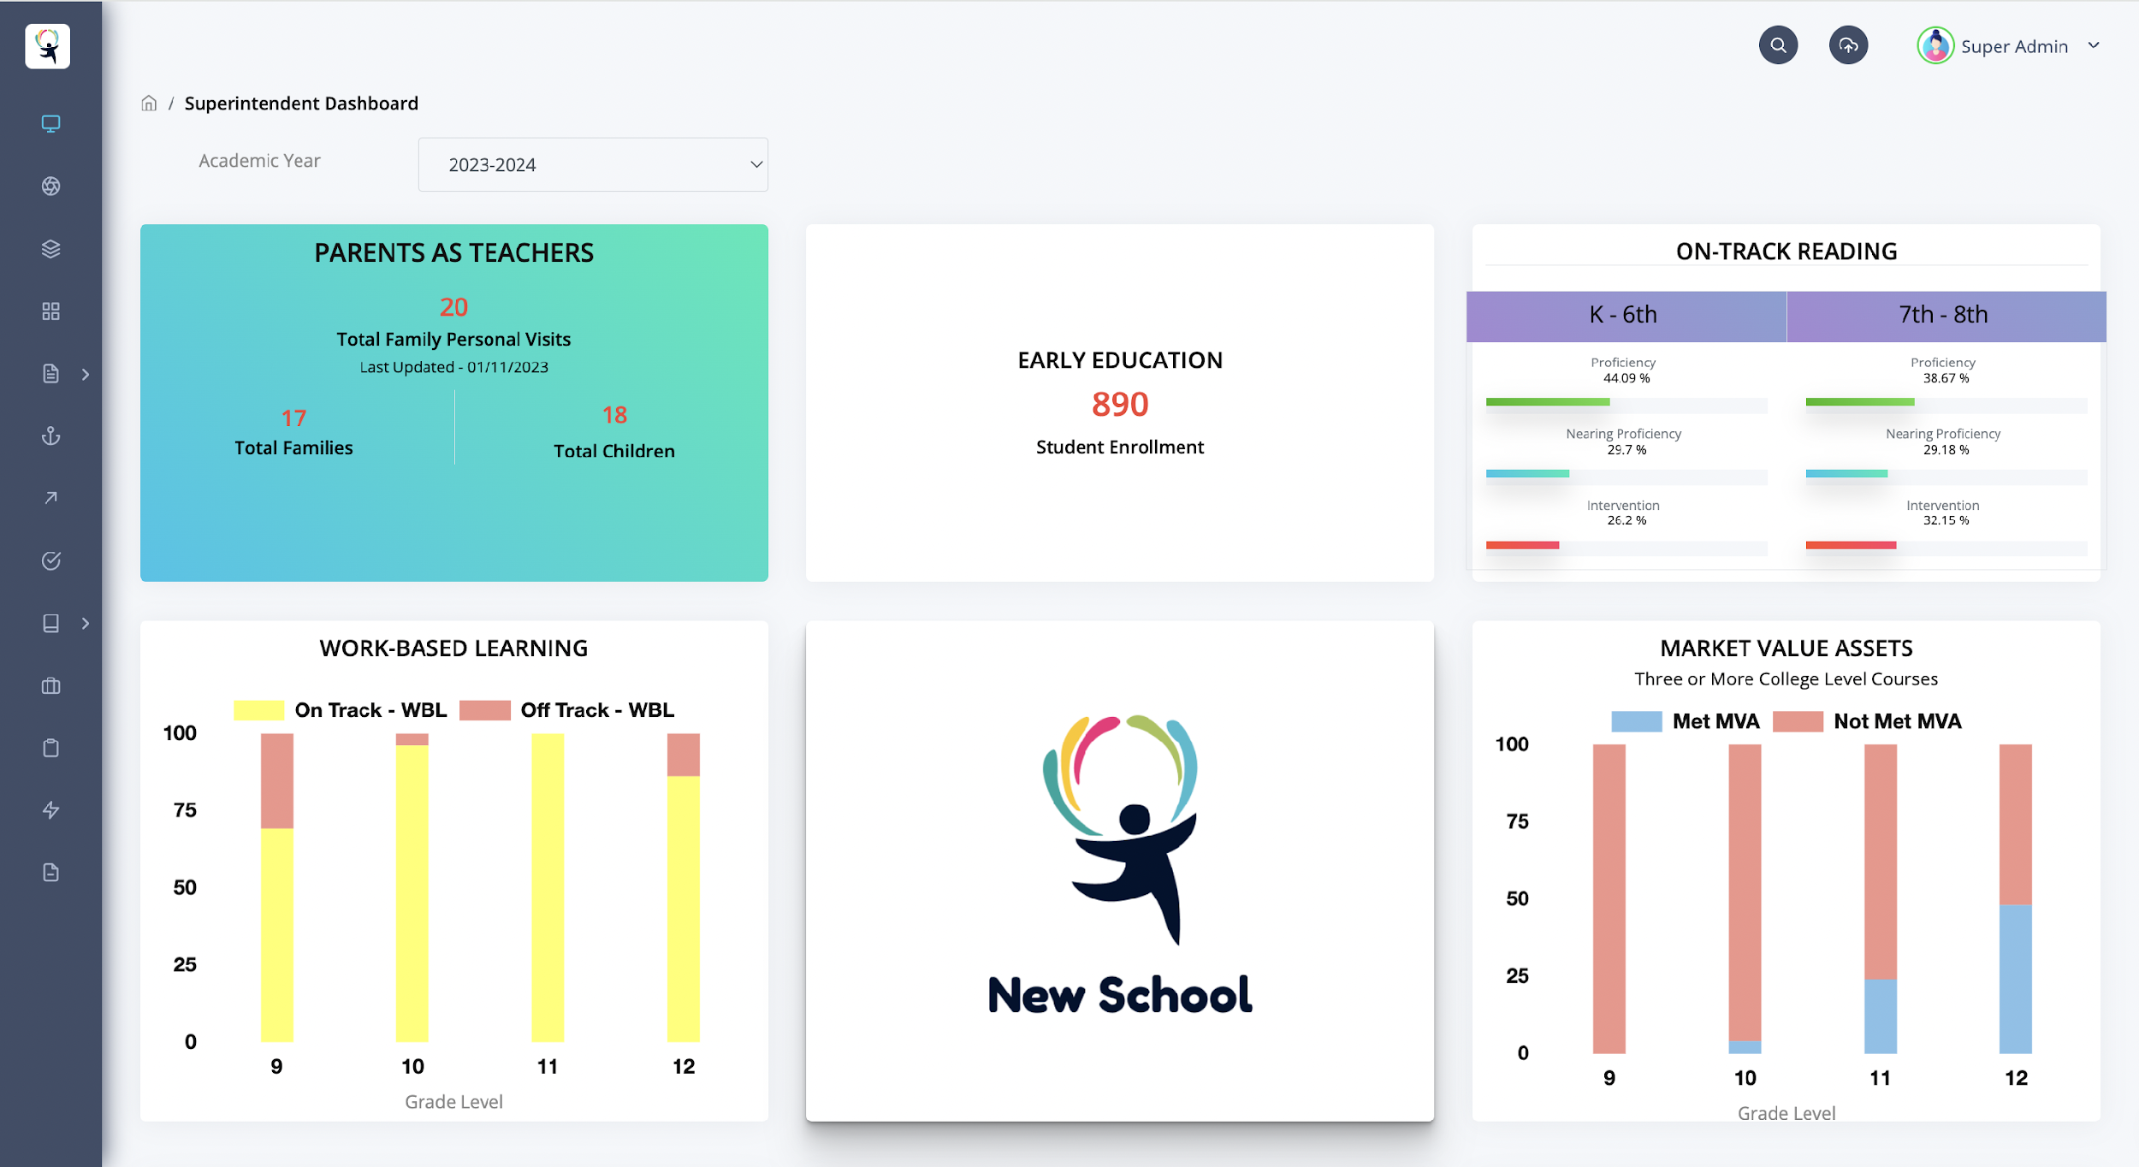

Slide 7
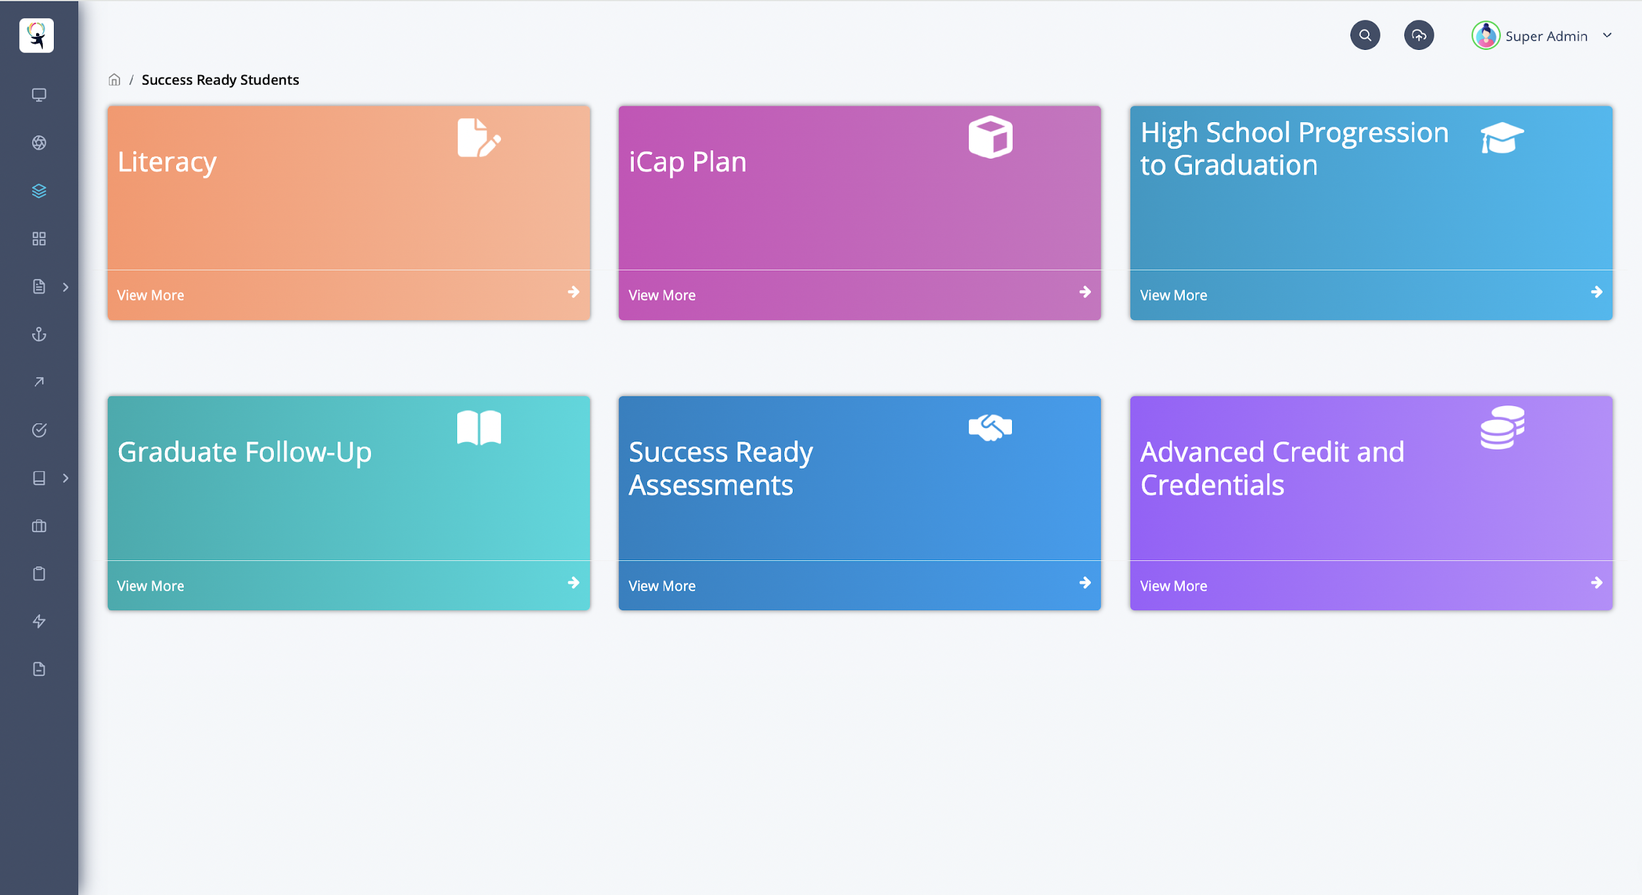

Slide 8
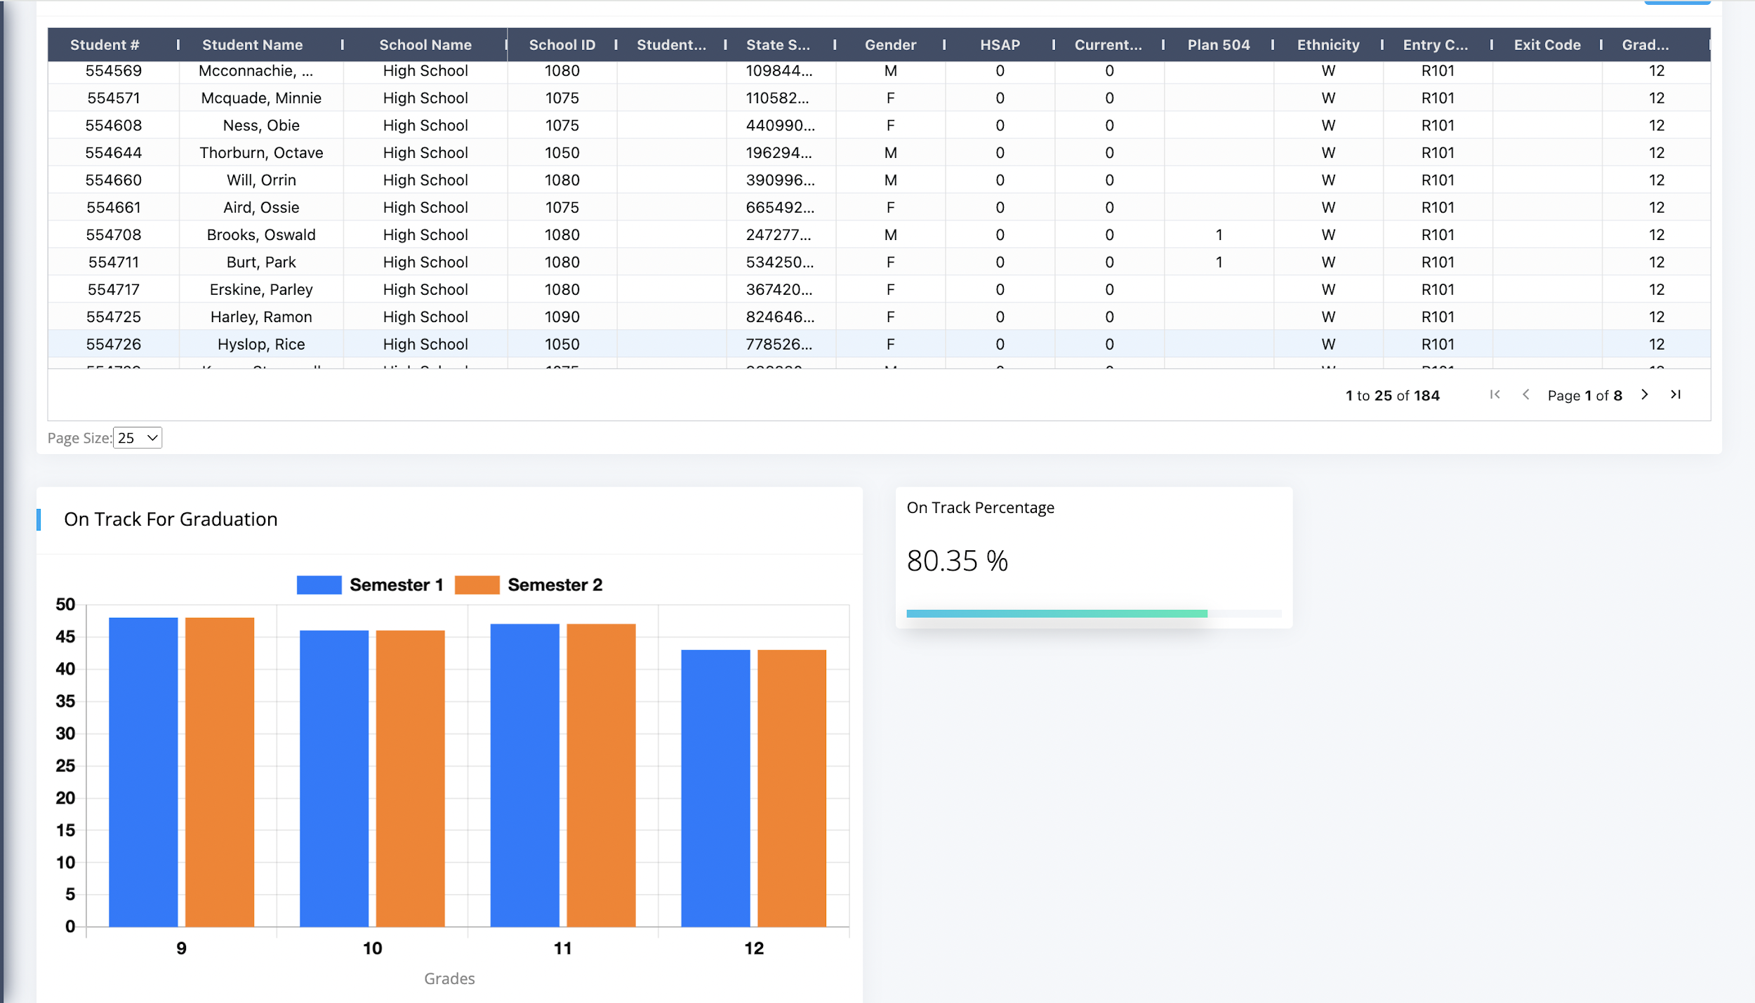

Slide 9
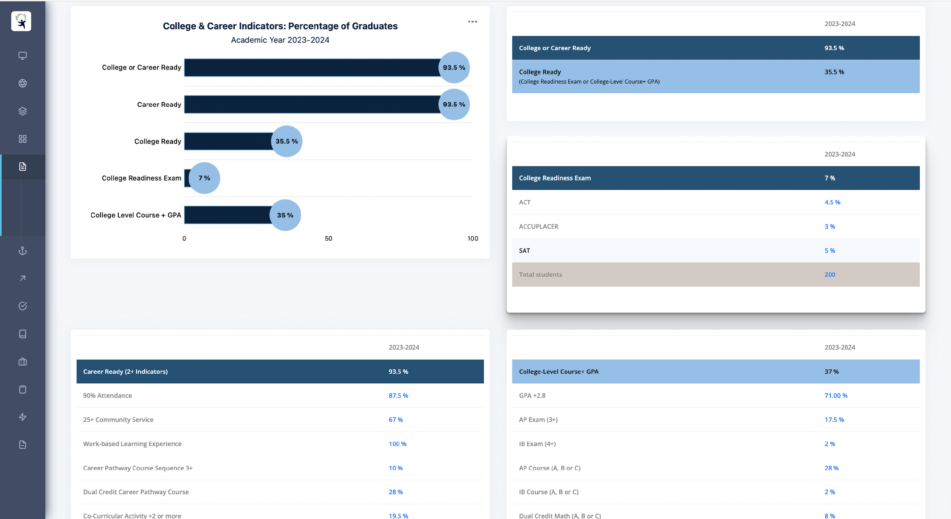

Slide 10
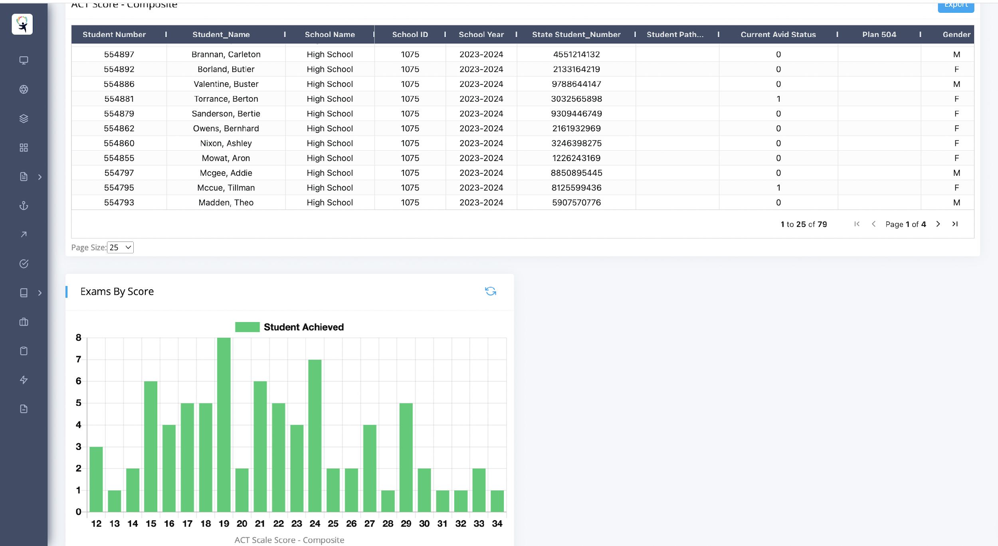

Slide 12
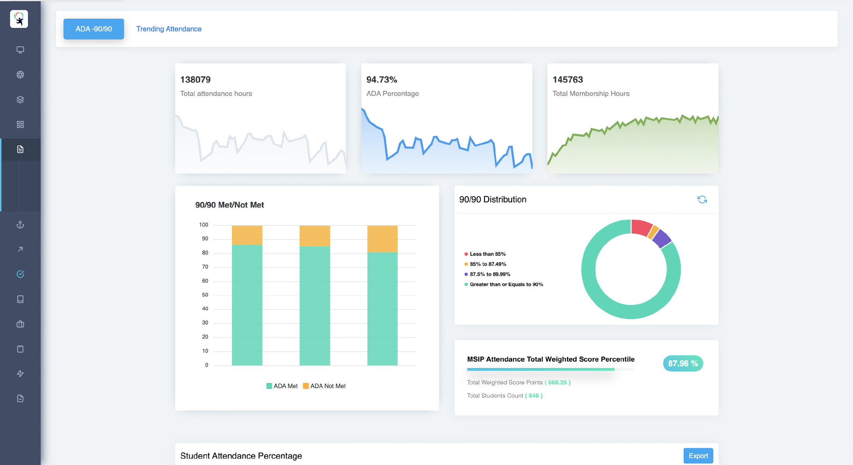

Slide 13
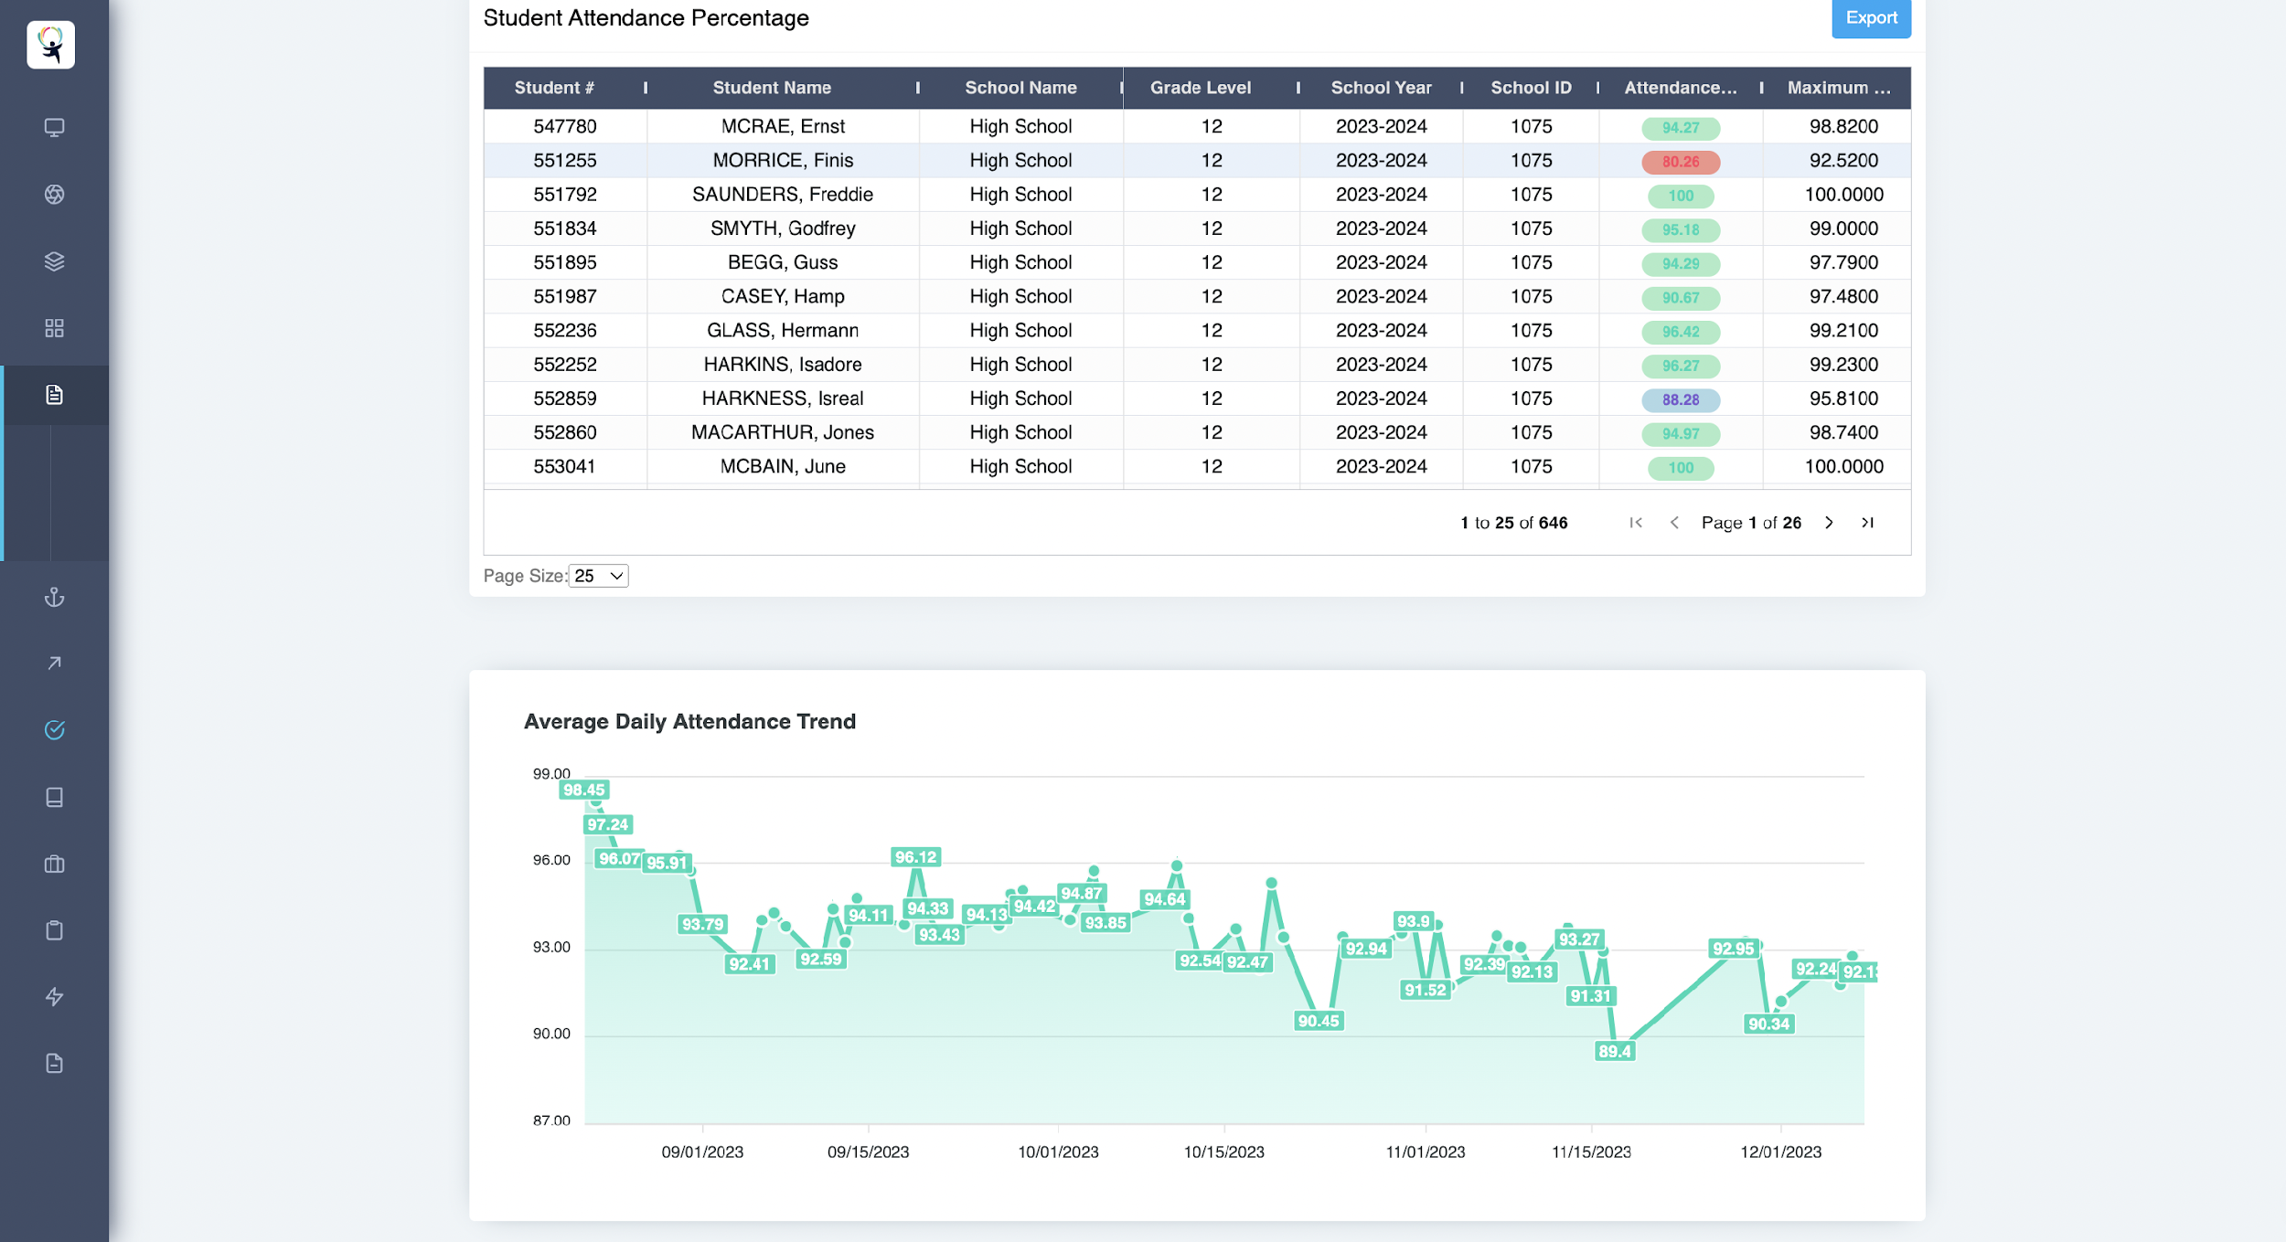

Slide 14
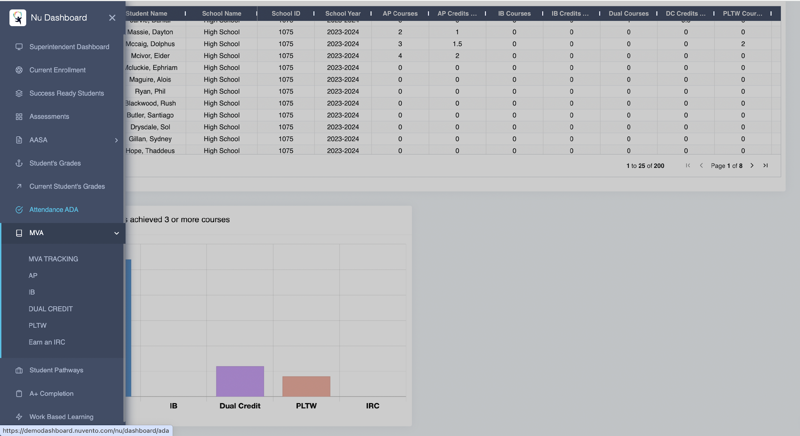

Slide 15
Questions & Attached for Review
Attached for your review:
  Memo outlining selection criteria
  Full proposal and quote from Nuvento

